Slide 1

Intelligent Agent - Chatbot v1.0.0

Slide 2
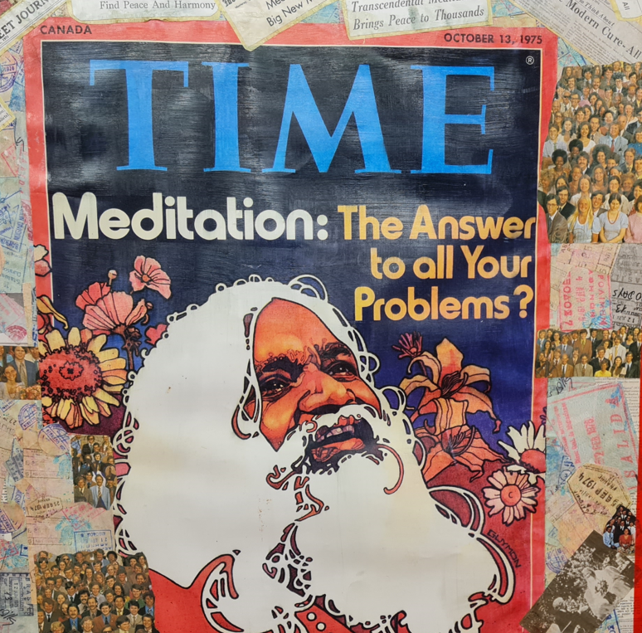
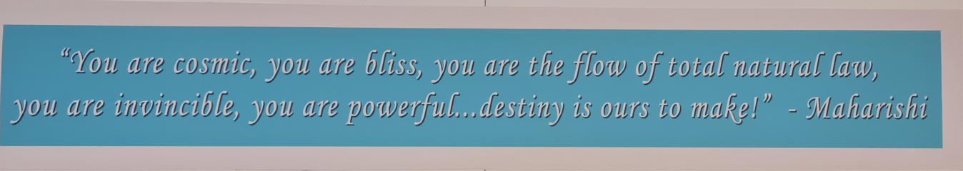
“I hold that life is bliss. In essence, life is not a struggle” – Maharishi Mahesh Yogi

Slide 3
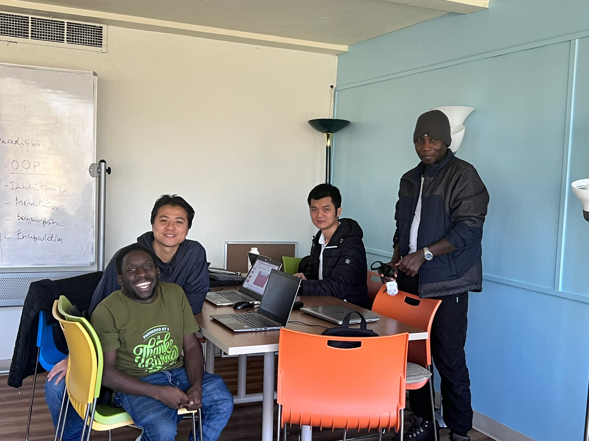
Team Information
Professor: Dr. Emdad Khan
Students:
616917: Geoffrey Duncan Opiyo
616965: Phuong Khanh Nguyen
616947: Deo Mugabe
616922: Duc Phi Ngo

Slide 4
Content
Agent Use-Cases
Problem statement & introduction
Agent and its Architecture
LLM, Vector store & Similarity search
Project Demo & improvement plan
Notes:
Exploration of products: Pacing order by the customers.
Place Order: Tracking order by the customers.
Report Generation: This is a unique use case by using LLM to run DB query on behalf of non-techie users. The user just tell a bot in human language of the task he/she wants completed. The bot then completes it and returns report to users in HTML format (abstracting the technical SQL complexity).
Customer Service:

Slide 5
AGENT USE-CASES
Chat bot with Effective Communication
Explore – find product
Place Order
Non-techie user reports
Customer Service
Notes:
Exploration of products: Pacing order by the customers.
Place Order: Tracking order by the customers.
Report Generation: This is a unique use case by using LLM to run DB query on behalf of non-techie users. The user just tell a bot in human language of the task he/she wants completed. The bot then completes it and returns report to users in HTML format (abstracting the technical SQL complexity).
Customer Service:

Slide 6
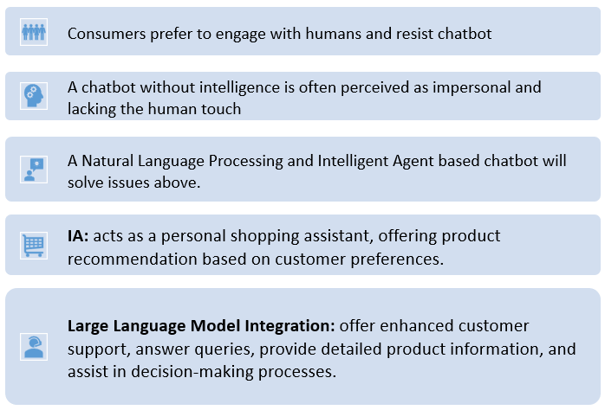

Problem statement & Introduction
Various food products for my retail website
Notes:
Intelligent Agent Implementation: The IA will act as a personal shopping assistant, offering product recommendations based on customer preferences, previous purchases, and browsing behavior. This agent will be adept at understanding customer needs through natural language processing, enabling it to interact with customers in a conversational manner.
Large Language Model Integration: Leveraging a LLM like GPT, the website will offer enhanced customer support, answer queries, provide detailed product information, and assist in decision-making processes. The model's ability to generate human-like text will make the interaction more engaging and informative.
Personalized Experience: By combining customer data with the analytical prowess of IA and the linguistic capabilities of LLM, each customer's experience will be uniquely tailored to their preferences and shopping history.
User Interface and Experience: The integration will be seamless, ensuring that the website remains user-friendly while incorporating these advanced technologies.
Expected Outcomes:
Enhanced customer engagement and satisfaction.
Increased efficiency in finding and selecting products.
Improvement in sales and customer retention.
A rich dataset for further refinement of customer service and product offerings.
Project Timeline and Milestones: [To be developed based on project scope and resources]
Technical Considerations: We will ensure the highest standards of data privacy and security, adhering to relevant regulations and ethical guidelines in AI deployment.

Slide 7
Problem statement & Introduction
[Chat bot] – Why are they the next big thing?
[Chat bot] – “Conversation as a Platform” - Better customer service and they could even differentiate your business from the crowd.
Examples: Apple – Siri, Microsoft – Cortana, Google – Google Assistant, Amazon – Alexa, and Meta “Facebook” – ITS ALIVE.io, to name but a few.
Notes:
Exploration of products: Pacing order by the customers.
Place Order: Tracking order by the customers.
Report Generation: This is a unique use case by using LLM to run DB query on behalf of non-techie users. The user just tell a bot in human language of the task he/she wants completed. The bot then completes it and returns report to users in HTML format (abstracting the technical SQL complexity).
Customer Service:
Title: "Problem statement & Introduction" - This indicates that the slide aims to introduce the issue at hand and provide an opening remark on the topic.
Central Question: "[Chat bot] – Why are they the next big thing?" - This is a rhetorical question posed to capture the audience's attention, suggesting that the ensuing content will explore the importance and rising prominence of chatbots.
Key Point: The text highlights chatbots as a "Conversation as a Platform" service, suggesting that they represent an evolutionary step in customer service by offering conversational interactions, as opposed to traditional point-and-click interfaces.
Value Proposition: It posits that chatbots can significantly improve customer service and differentiate a business from its competitors by providing a more personalized and engaging user experience.
Industry Examples: By mentioning Siri (Apple), Cortana (Microsoft), Google Assistant, Alexa (Amazon), and ITS ALIVE.io (presumably by Meta/Facebook), the slide provides real-world examples of successful chatbot implementations, illustrating their prevalence and importance across major tech platforms.
The slide conveys that chatbots are not just a trend but are becoming a fundamental component of customer interaction strategies in various industries. The inclusion of well-known chatbots supports the argument that they are indeed "the next big thing" in tech and customer service innovation.

Slide 8
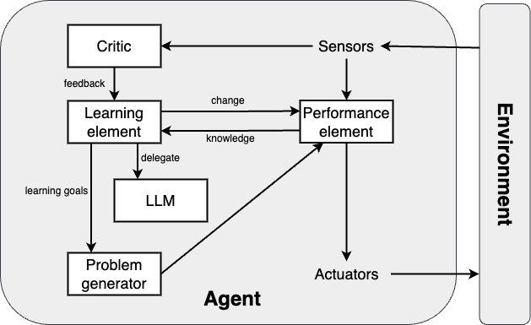
AGENT ARCHITECTURE
Learning agent

Slide 9
AGENT ARCHITECTURE
Learning element: makes improvements.
Performance element: selects external actions based on percept (entire agent in previous cases).
Critic: gives feedback to learning about success (it tells the learning element how well the agent is doing with respect to a fixed performance standard.
Problem generator: suggests actions to find new states.

Slide 10
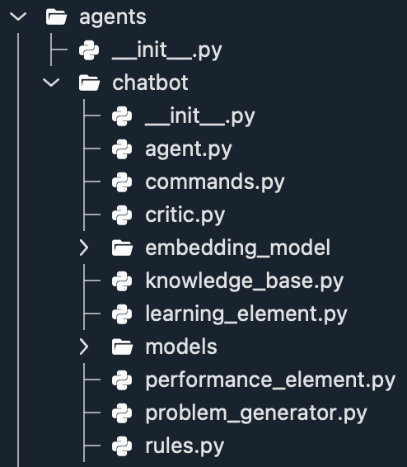
AGENT ARCHITECTURE
Project file structure

Slide 11
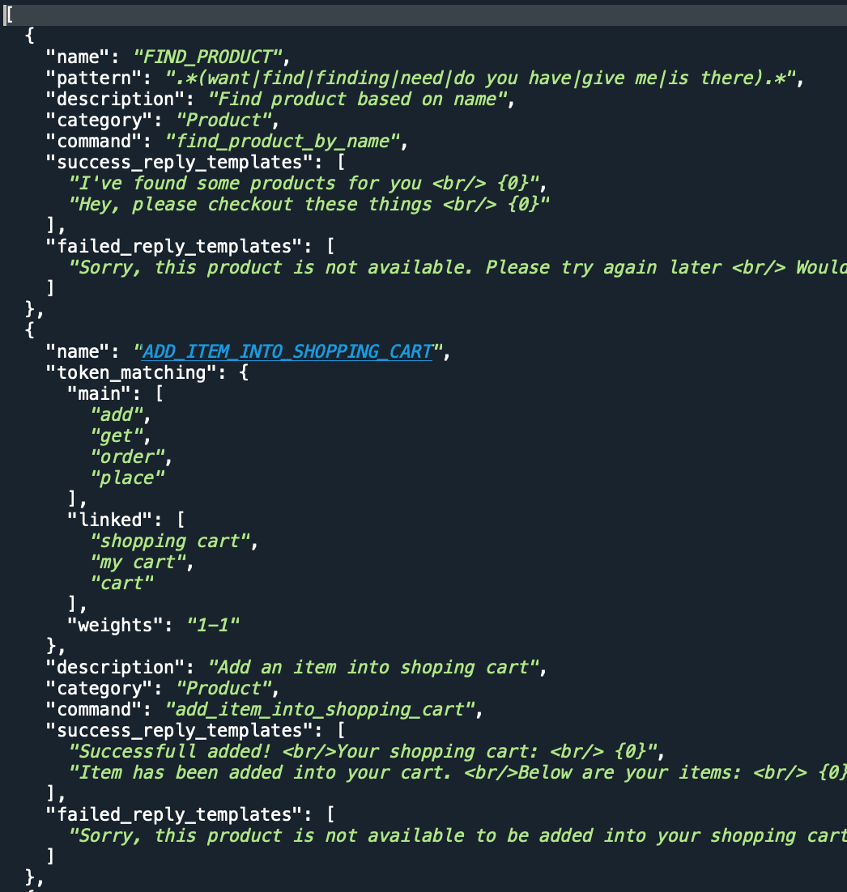
AGENT ARCHITECTURE
Rules.json

Slide 12
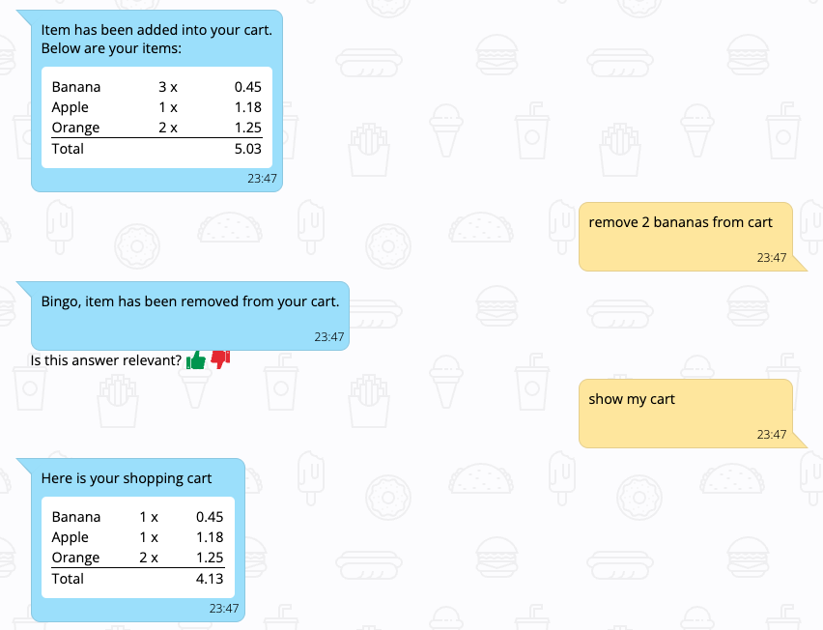

AGENT ARCHITECTURE
Learn from feedback

Slide 13
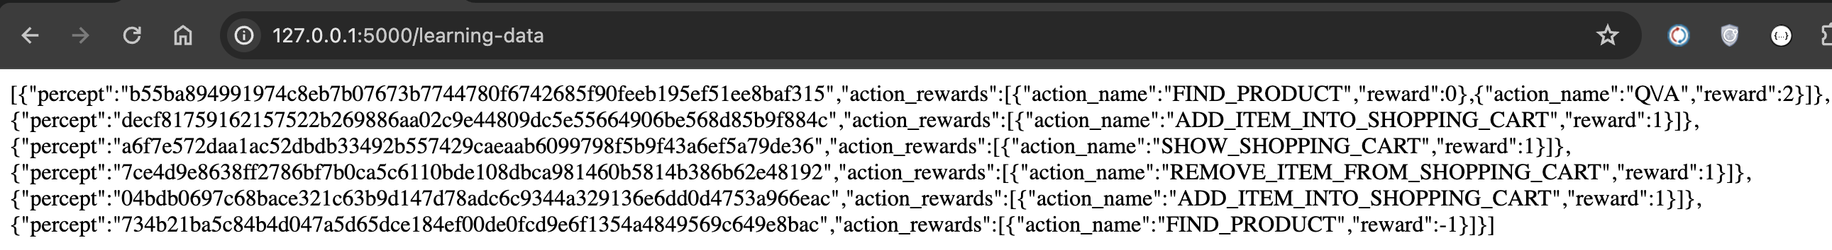
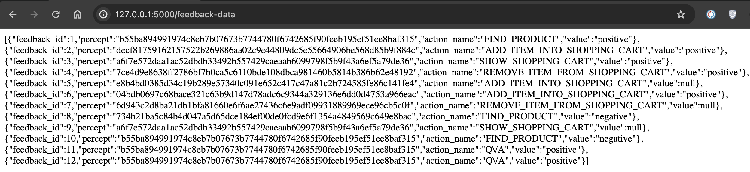
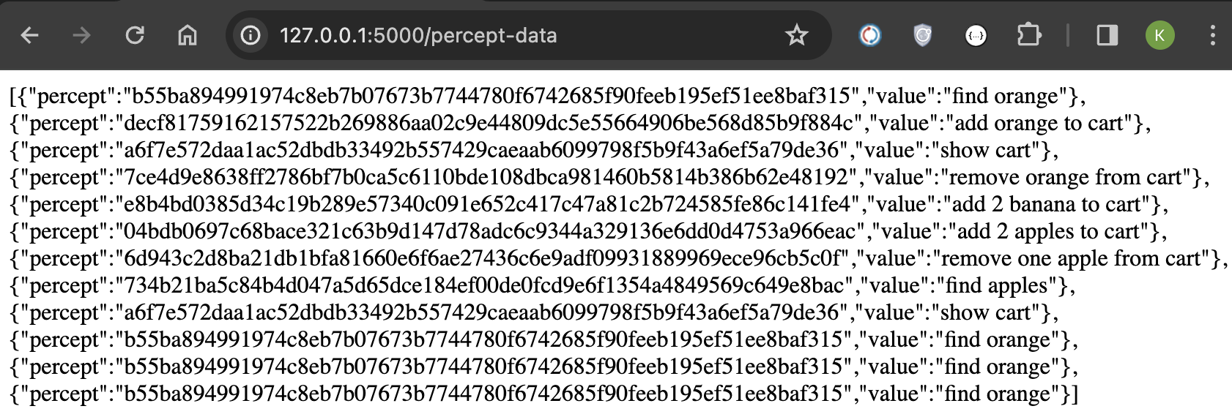
AGENT ARCHITECTURE

Slide 14
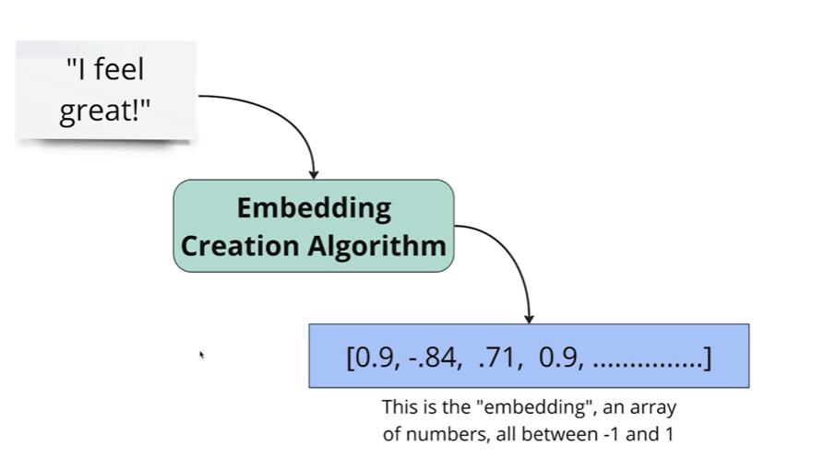
Split the text into separate chunk
Calculate embedding for each chunk
Store embedding in a database specialized for storing embedding
This facilitates fast searching, recommendation and classification
EMBEDDING
Notes:
1. Load Source Data: We loaded KB in JSON format into Vector Store

Slide 15
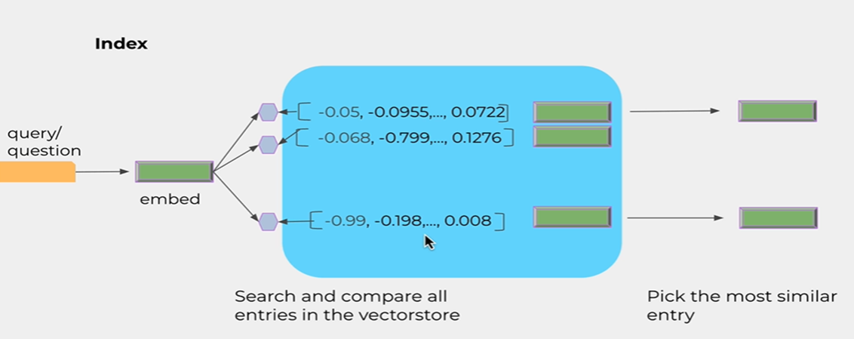
VECTOR SEARCH

Slide 16
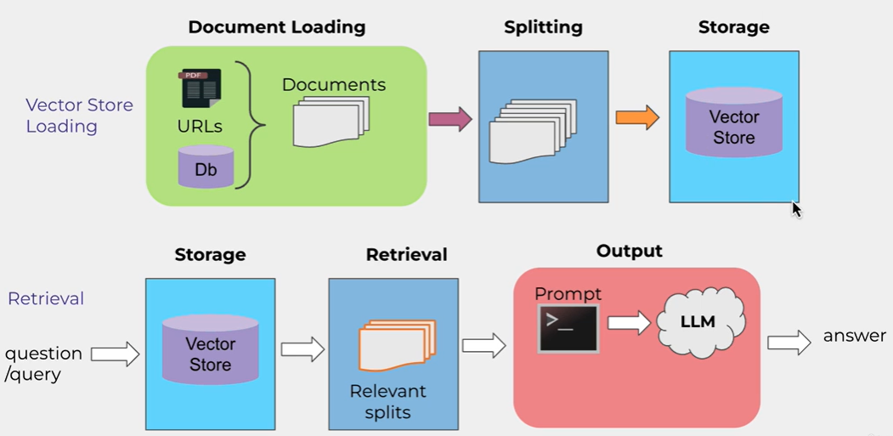
VECTOR STORAGE OF OUR “KB” INTO VECTOR DATABASE FAISS
Notes:
1. Load Source Data: We loaded KB in JSON format into Vector Store

Slide 17
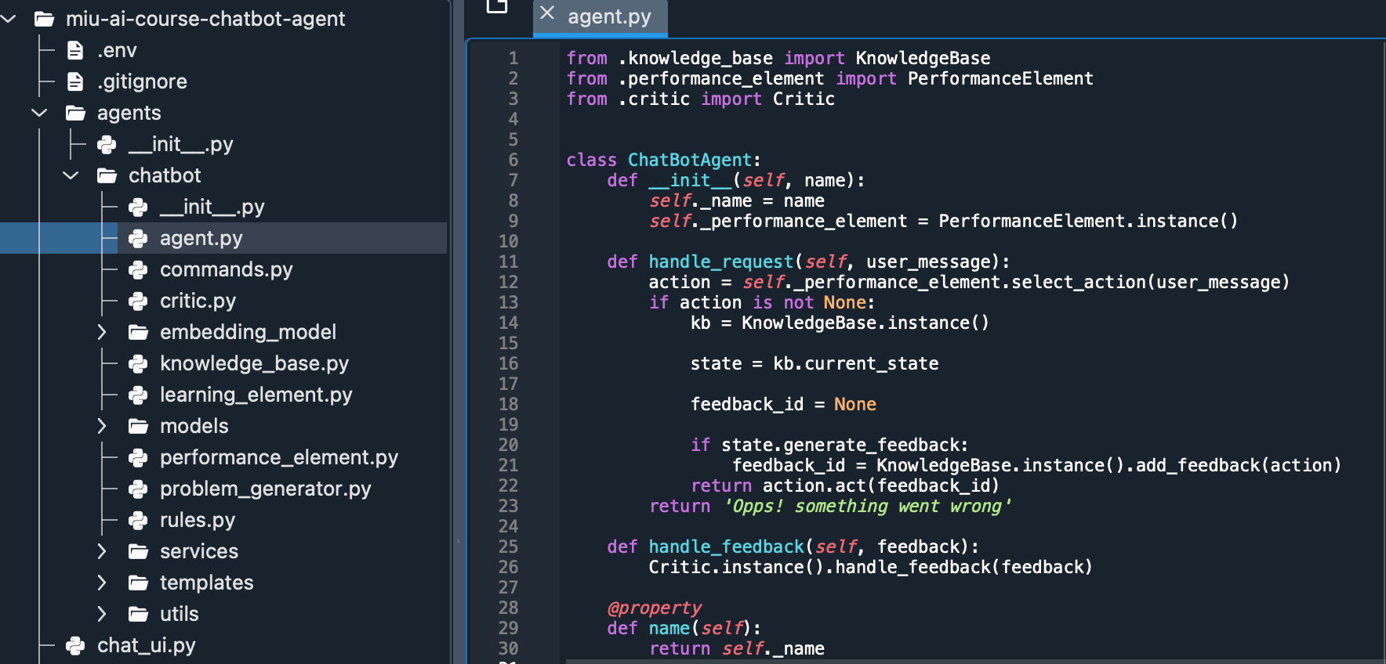
A SNEAK PEEK INTO THE CODE BASE

Slide 18
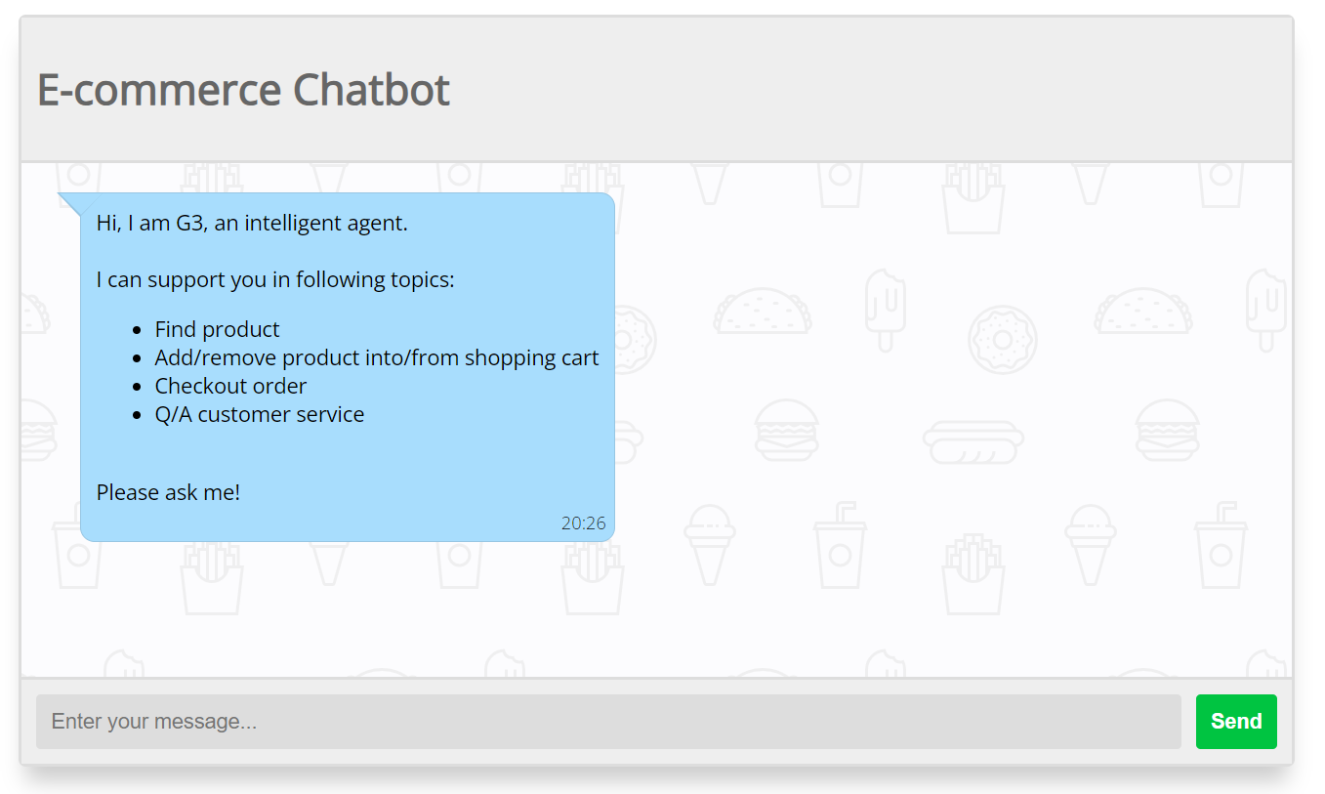
A DEMO

Slide 19
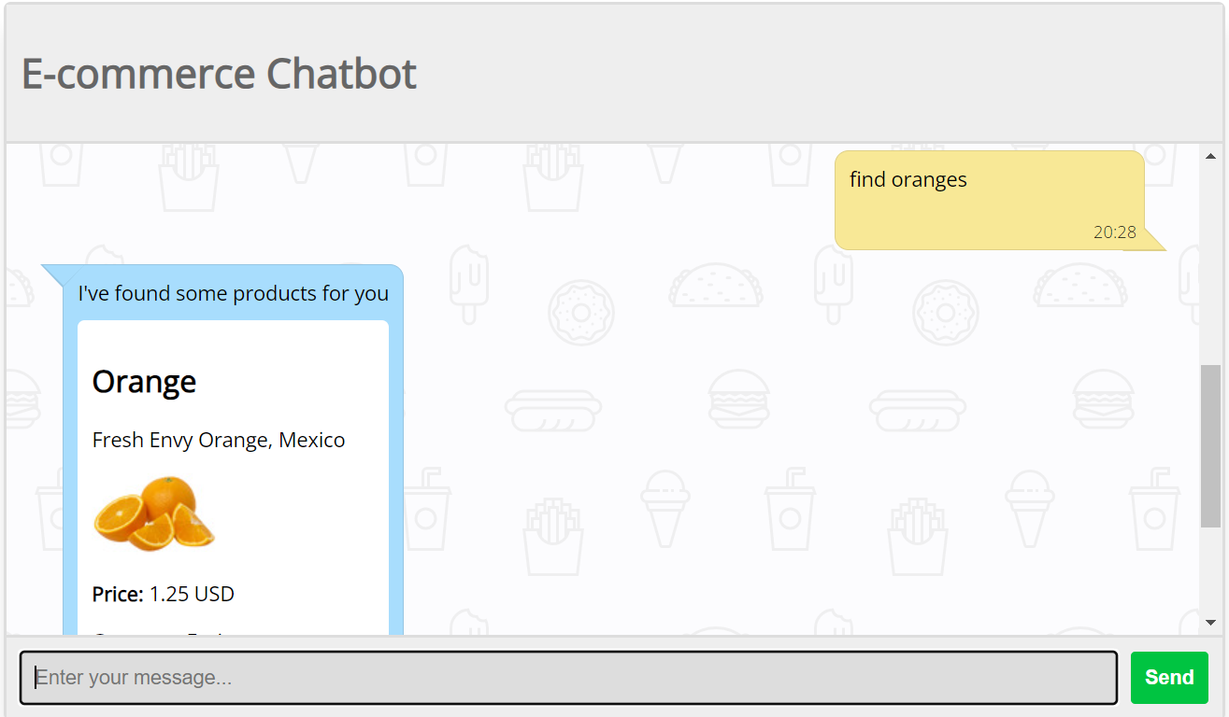
A DEMO

Slide 20
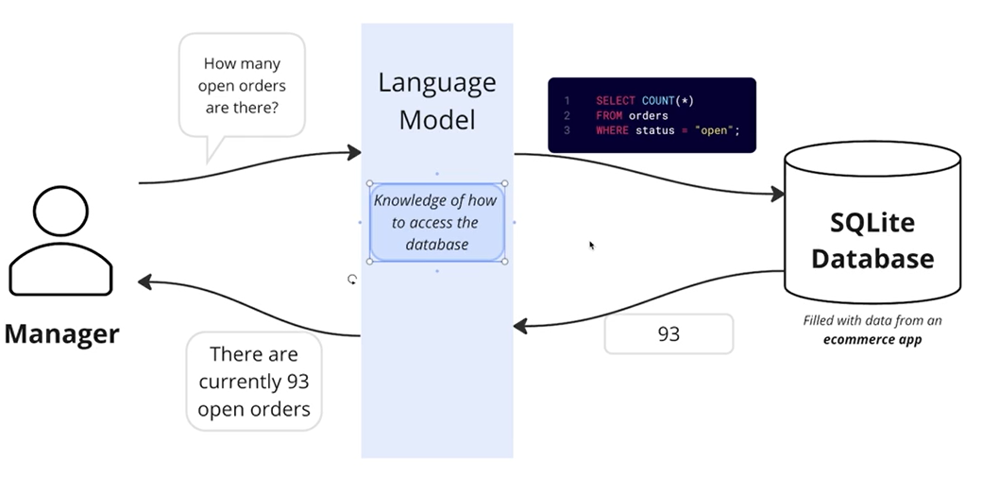
IMPROVEMENT REQUIRED: Report Module for an E-commerce Employee who is a Non-Techie

Slide 21
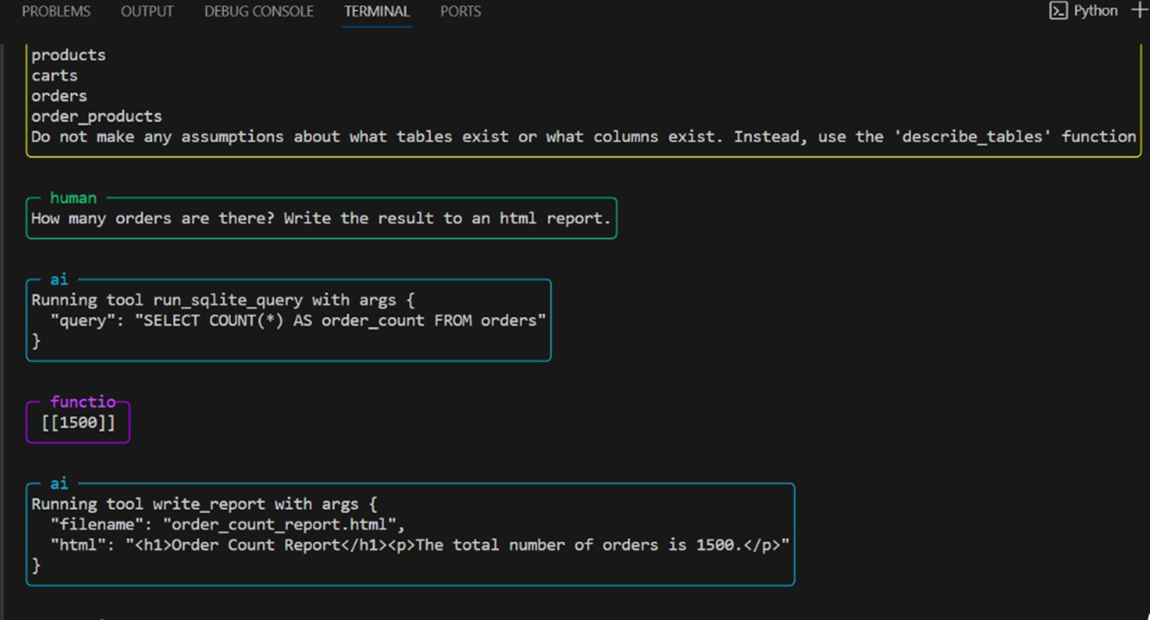
IMPROVEMENT REQUIRED: Report Module for an E-commerce Employee who is a Non-Techie

Slide 22

Practice TM
Group 3 – with LOVE
Wisdom
Creativity
Unbounded Awareness

